Slide 1

CS 560: Software Engineering
Configuration Management
Dr. Mohammed Ayoub Alaoui Mhamdi
Bishop's University
Sherbrooke, Qc, Canada
malaoui@ubishops.ca
Notes:
© SE, Introduction, Hans van Vliet

Slide 2
Configuration management tasks
identification and definition of configuration items, such as source code modules, test cases, requirements specification
managing changes and making configuration items available during the software life cycle, usually through a Configuration Control Board (CCB)
keeping track of the status of all items (including the change requests)
crucial for large projects
Notes:
© SE, Configuration Management, Hans van Vliet
A software system itself is not monolithic. Software systems exist in different versions or configurations.
Different versions come about when changes are implemented after the system has been delivered to the customer.
From time to time, the customer is then confronted with a new release. Different versions of components of a system may also exist during development.

Slide 3
Configuration Control Board
ensures that every change to the baseline (change request - CR) is properly authorized and executed
CCB needs certain information for every CR, such as who submits it, how much it will cost, urgency, etc
CCB assesses the CR. If it is approved, it results in a work package which has to be scheduled.
so, configuration management is not only about keeping track of changes, but also about workflow management
Notes:
The way to go about this is to have one shared library or database that contains all approved items, the so-called baseline. Adding an item to this database, or changing an item, is subject to a formal approval scheme. For larger projects, this is the responsibility of a separate body, the Configuration (or Change) Control Board (CCB). The CCB ensures that any change to the baseline is properly authorized and executed. The CCB is staffed with people from the various parties involved in the project, such as development, testing, and quality assurance.
© SE, Introduction, Hans van Vliet

Slide 4
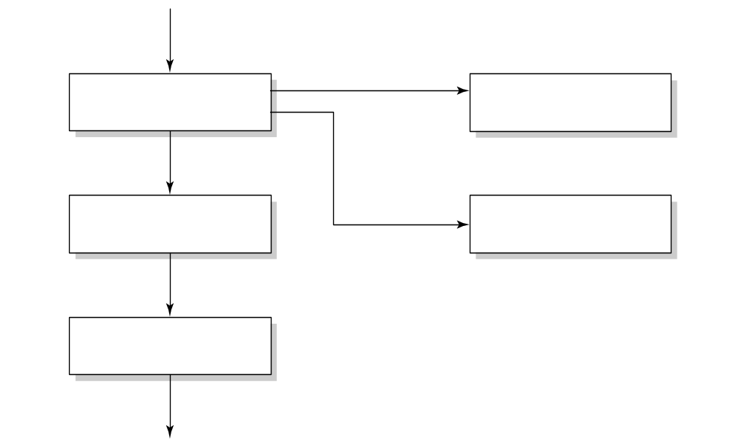
Workflow of a change request
change request (CR)
investigate
reject
notify owner
approve
schedule work
request info
defer
implement change
Notes:
Possible configuration items are:
– source code components,
– the requirements specification,
– the design documentation,
– the test plan,
– test cases,
– test results,
– the user manual.
© SE, Introduction, Hans van Vliet

Slide 5
Tool support for configuration management
if an item has to be changed, one person gets a copy thereof, and meanwhile it is locked to all others
new items can only be added to the baseline after thorough testing
changes in the status of an item (e.g. code finished) trigger further activities (e.g. start unit testing)
old versions of a component are kept as well, resulting in versions, like X.1, X.2, …
we may even create different branches of revisions: X.2.1, X.2.2, … and X.3.1, X.3.2, ...

Slide 6
Functionalities of SCM tools
Components (storing, retrieving, accessing, …)
Structure (representation of system structure)
Construction (build an executable)
Auditing (follow trails, e.g. of changes)
Accounting (gather statistics)
Controlling (trace defects, impact analysis)
Process (assign tasks)
Team (support for collaboration)
Notes:
Construction. SCM tools support the construction of an executable version of the system. By default, the latest version of all configuration elements is used,
but it is also possible to regenerate older versions of the system. Auditing. SCMtools allow one to follow trails: which changes have been made to this component, who did those changes, and why. This way, a searchable archive of the system is maintained. Accounting. The searchable archive allows one to gather statistics about the system and the development process. We may for instance search for components that are changed very often, and hypothesize about the quality of those components. Controlling. SCM tools may be used for traceability purposes. If sufficient
information is stored, we may trace defects to requirements, analyze the impact of changes, and the like. Process. SCM tools may support users in selecting tasks and performing those tasks in the appropriate context. For instance, the tool may assist in assigning the handling of a change request to a certain developer, and automatically provide her with a workspace with the components that need to be changed. Team. SCM tools may support collaboration, for example by generating a workspace for a group of collaborating developers, by noticing conflicts between developers, and the like.
© SE, Introduction, Hans van Vliet

Slide 7
Models of configurations
version-oriented: physical change results in a new version, so versions are characterized by their difference, i.e. delta
change-oriented: basic unit in configuration management is a logical change
identification of configuration becomes different: “baseline X plus fix table bug” instead of “X3.2.1 + Y2.7 + Z3.5 + …”
Notes:
© SE, Introduction, Hans van Vliet

Slide 8
Evolution of SCM tools
Early tools: emphasis on product-oriented tasks
Nowadays: support for other functionalities too. They have become a (THE) major tool in large, multi-site projects
Agile projects: emphasis on running system: daily builds
Notes:
Many SCM tools employ the version-oriented model of configurations. A physical change in a component then results in a new version, and different versions are thus characterized by their difference. Some tools use logical changes, rather than physical ones, as a basic unit of work in configuration management. This so-called change-oriented model gives a more intuitive way of working and may prevent a lot of user errors when configuring a system.
© SE, Introduction, Hans van Vliet

Slide 9
Configuration Management Plan
Management section: organization, responsibilities, standards to use, etc
Activities: identification of items, keeping status, handling CRs

Slide 10

Summary
CM is about managing all kinds of artifacts during software development
Crucial for large projects
Supported by powerful tools
Notes:
Configuration items must be identified and defined. A configuration item is a collection of elements that is treated as one unit for the purpose of configuration management. Examples of possible configuration items are the requirements specification, a software component, a test report, and the user documentation.
The release and change of these items throughout the software life cycle must be controlled. This means that orderly procedures must be established as to whom is authorized to change or release configuration items.
The status of configuration items and change requests must be recorded and reported. For example, the status of a change request may be: proposed, approved, rejected, or incorporated.
© SE, Introduction, Hans van Vliet

